Slide 1

Skycrest
Elementary School
State of School 2025
Notes:
https://www.youtube.com/watch?v=lpYPEUJObQ0

Slide 2
Grading Scale
School Grading Scale:
A = 62% of points or greater
B = 54% to 61% of points
C = 41% to 53% of points
D = 32% to 40% of points
F = 31% of points or less
Past School Grades:
2019: C
2020: NA No School Grades
2021: C
2022: C
2023: C 47%
2024: A 68%
2025: A 65% (Goal)

Slide 3
School Grade Cells
ELA | Math | Science
3rd-5th Proficiency | 3rd-5th Proficiency | 5th Proficiency
3rd Proficiency
Learning Gains | Learning Gains
Low 25% Learning Gains | Low 25% Learning Gains

Slide 4
ELA
^{Proficiency Goal 65%}
^{Need 53 more students!}

Slide 5
Math
Skycrest Elementary School
FAST Data MATH
2024-2025
 | PM1 22-23 | PM1 23-24 | PM1 24- 25 |  | PM2 22-23 | PM2 23-24 | PM2 24-25 | 24-25 PM1 -PM2
3rd Grade | 1% | 2% | 9% |  | 24% | 15% | 15% | 6%
4th Grade | 2% | 7% | 4% |  | 14% | 14% | 10% | 6%
5th Grade | 8% | 7% | 23% |  | 33% | 30% | 35% | 12%
2024-2025 MATH 3rd -5th Grade
 | PM1 | PM2 | Growth
Skycrest | 12% | 20% | 8%
Pinellas | 15% | 27% | 12%
Florida | 11% | 22% | 11%
Proficiency Goal 65%
105 more students

Slide 6

Science
2023 | 2024 | Difference
48% | 59% | 11%

Slide 7
Learning Gains
 | 2024 | 24-25 PM2 | Difference
ELA LG | 72% | 36% | 36%
ELA Low 25% | 82% | 32% | 50%
Math LG | 82% | 9% | 73%
Math Low 25 % | 82% | 24% | 58%
Talk to a neighbor about this data?

Slide 8
PRIMARY
STAR PM1 to PM2 Comparison Data
2024-2025 STAR DATA
 | ELA |  | MATH
 | PM1 | PM2 | PM1 | PM2
Kindergarten | *10 | *40 | 3 | 21
1st Grade | 15 | 33 | 4 | 19
2nd Grade | 21 | 23 | 7 | 32

Slide 9
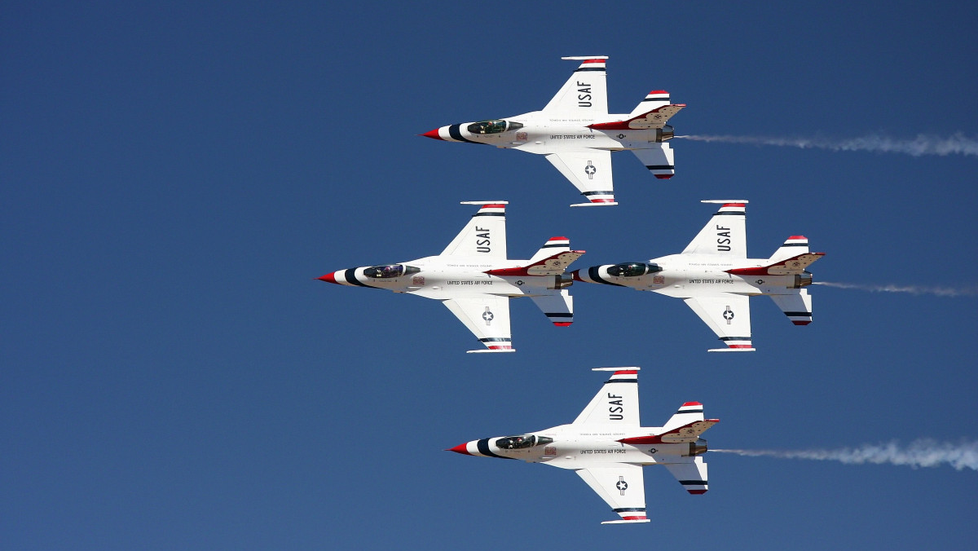
Whats Next?

Slide 10
Flight Path
Staying the Course/ Following Timelines
All Hands on Deck
Understanding
the Data
Breaking Down Barriers
Adjusting Schedules
Refining Interventions
Aggressive Monitoring
Know the Kids!
Accountable Discourse
Consistency & Focus
Notes:
Hays
Specials
Tutoring during specials

Slide 11
I Can! I will! Attitude
Intentional planning, standards based instruction and targeted intervention to meet the needs of all students.

